Slide 1

Do overall student trends hold true for female students across different demographics and colleges?
Nicole Hamler
GENBA 894
27 July 2020

Slide 2
About the Data
K-State Student Information System
Years: 2012 through 2019
Student information reduced to non-identifiable data only
Maintained up to this point by recruitment and admission offices
Total rows (i.e. student applicants) prior to data cleaning: 132,722 with 185 data points. This was then initially reduced to relevant data of 109,827 rows and 17 data points.

Slide 3
The Data - Descriptions
State – State indicated in the permanent address, codes / abbreviations
Age of Student (calculated field based on birthdate)
Citizenship (as submitted by international students): Country abbreviations / codes
Application Date: date the student application was received by the university
Admitted: calculated field based on if student had existing admitted date (1 = Admitted)
Enrolled: calculated field based on fi student had existing enrollment date (1 = Enrolled)
Withdrew: did the student end up withdrawing from the university (Y/N)
Program status – calculated fields below with 1 indicating positive for current status listed:
Deferred
Applied
Cancelled Application
Denied
Discontinued
In-State: indicates state of Kansas residency (1 = Yes)
Student Type – calculated fields based on admit type of students (1 indicating positive for specified admit / student type):
Freshman
International
Non-Traditional (includes Online, Transfer, Readmit)
Male: 1 = Male
Degree: 1 = Degree Seeking
Ethnicity – calculated field based on self-reported ethnicity by student (1 = positive for selected field)
Native American
Hawaiian Pac.
Multi Racial
African American
Asian
Hispanic
White
Colleges (focused) – calculated field based on program / college student applied to (1 = positive for selected field):
Business
Engineering
Arts & Sciences
Year – Calculated field based on the term the student applied for

Slide 4
Data Transformation & Cleaning
Data reduced to the 17 data points / variables as detailed in prior slide
Deletion of unnecessary data
Rows that presented outliers or demographics (e.g. student types that did not fall within cohorts below)
Fields that were not needed for this analysis (e.g. test scores)
Deletion of personal identifiable data
Categorical data changed to numerical true/false
Data separated into three main cohorts of students:
Freshmen
Non-Traditional
International
Filling null values with mean or data indicating that there is no value in the particular field.

Slide 5
Student Cohort Details - Freshman
 | Age
Mean | 18.15
Min | 17
Max | 19
Admit type
Freshman
Age
Less than or equal to 19
Total Count:
44,225
 | Admitted | Enrolled | In-State
Mean | .97 | .39 | .69
Std | .16 | .49 | .46

Slide 6
Student Cohort Details – Non-Traditional
 | Age
Mean | 24.69
Min | 20
Max | 60
Admit types
Online
Transfer
Readmit
Age
20+
Total Count
18,841
 | Admitted | Enrolled | In-State
Mean | .94 | .54 | .52
Std | .24 | .50 | .50

Slide 7
Student Cohort Details – International
 | Age
Mean | 21.36
Min | 17
Max | 59
Admit type
International
Age
All ages
Total Count
7,569
 | Admitted | Enrolled | Cancelled App
Mean | .92 | .30 | .19
Std | .26 | .46 | .39

Slide 8

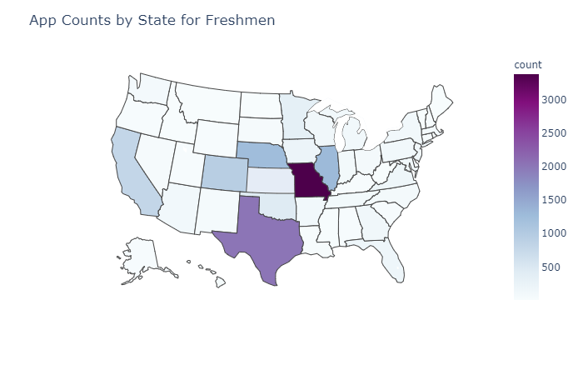
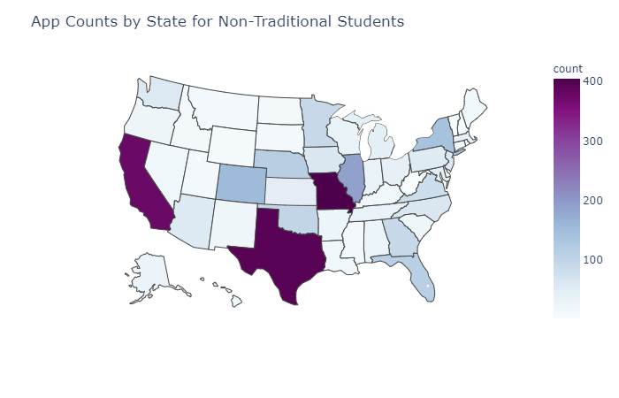
Domestic Student Analysis – Freshmen and Non-Traditional students
Missouri: 3,377
Texas: 2,019
Illinois: 1,292
Nebraska: 1,243
Colorado: 938
California: 793
Oklahoma: 445
Missouri: 404
Texas: 393
California: 375
Illinois: 189
Colorado: 152
Nebraska: 113
Oklahoma: 98

Slide 9
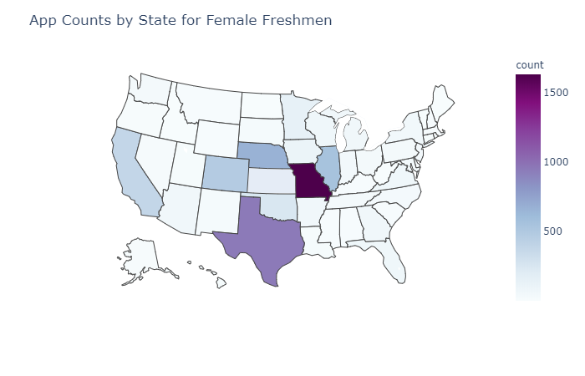
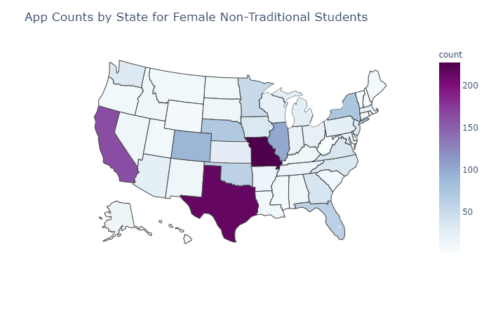
Domestic Student Analysis – all Female Students
Missouri: 1,625
Texas: 946
Illinois: 553
Nebraska: 664
Colorado: 475
California: 382
Oklahoma: 250
Missouri: 227
Texas: 214
California: 162
Illinois: 101
Colorado: 90
Nebraska: 70
Oklahoma: 60

Slide 10
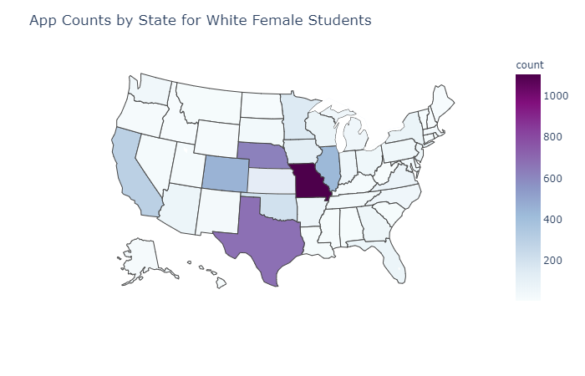
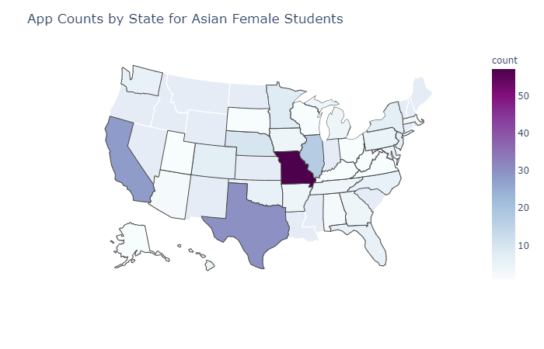
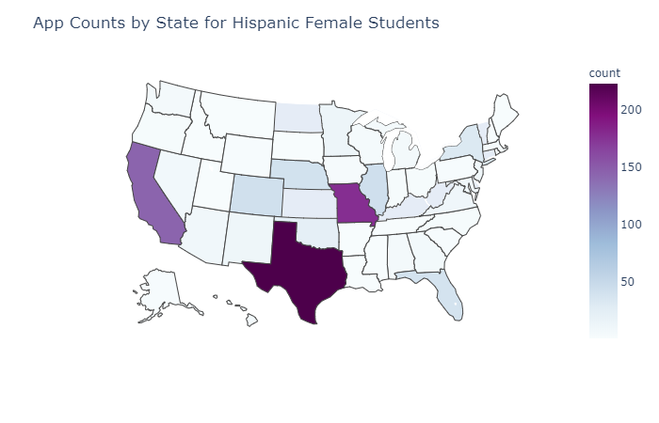
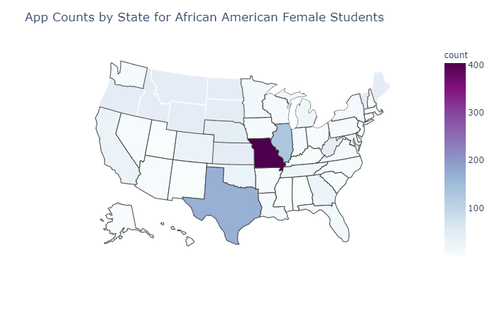
Domestic Student Analysis – female students - a closer look by ethnicity

Slide 11
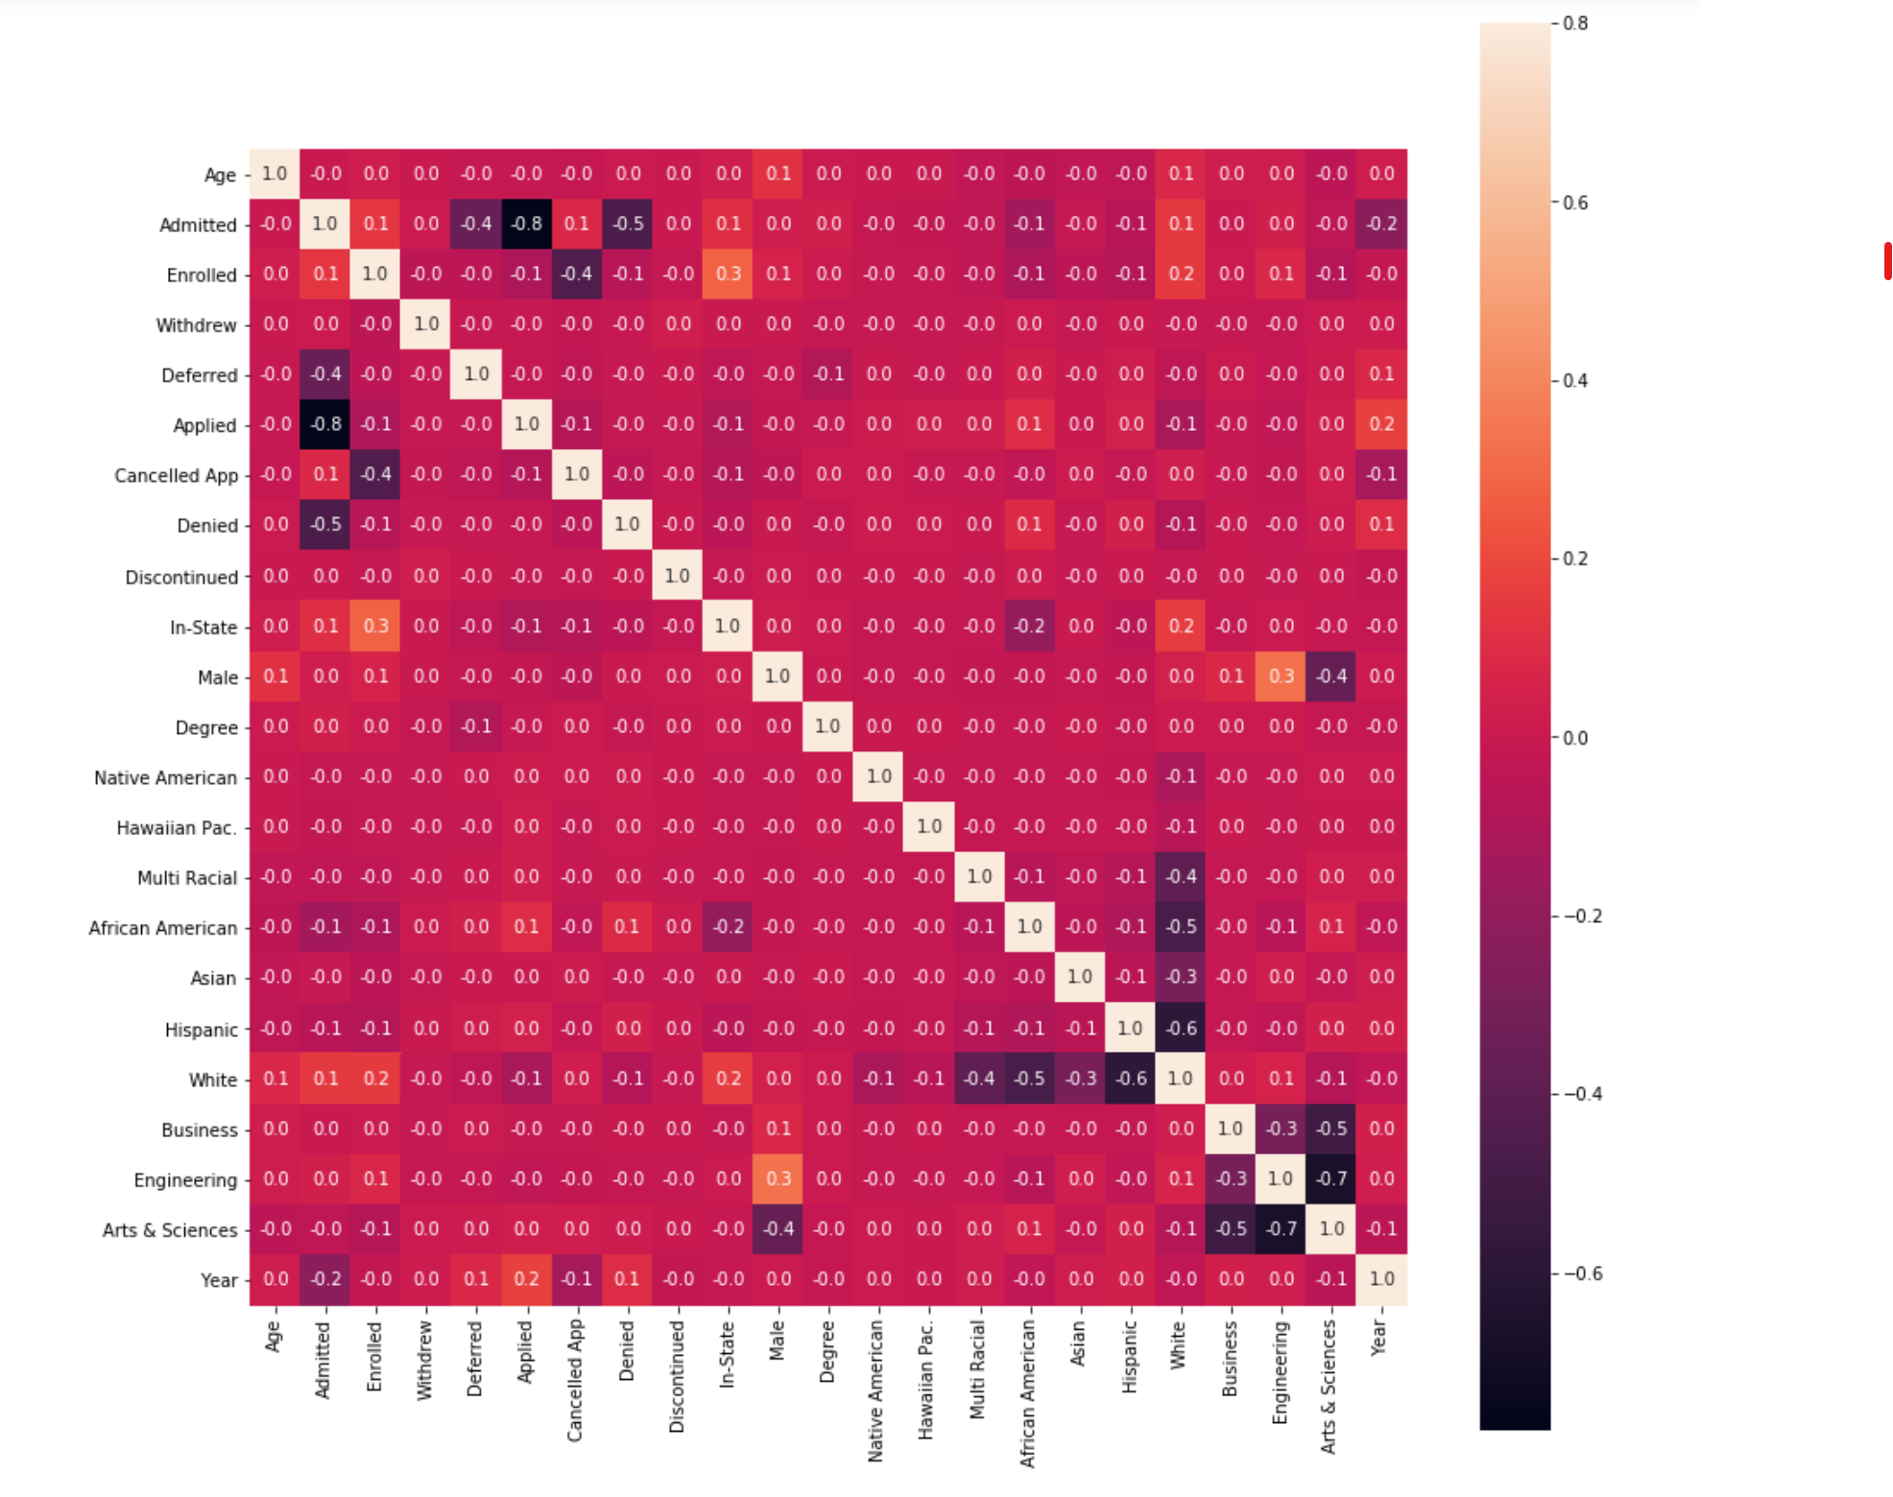
Correlation Analysis – Freshmen

Slide 12
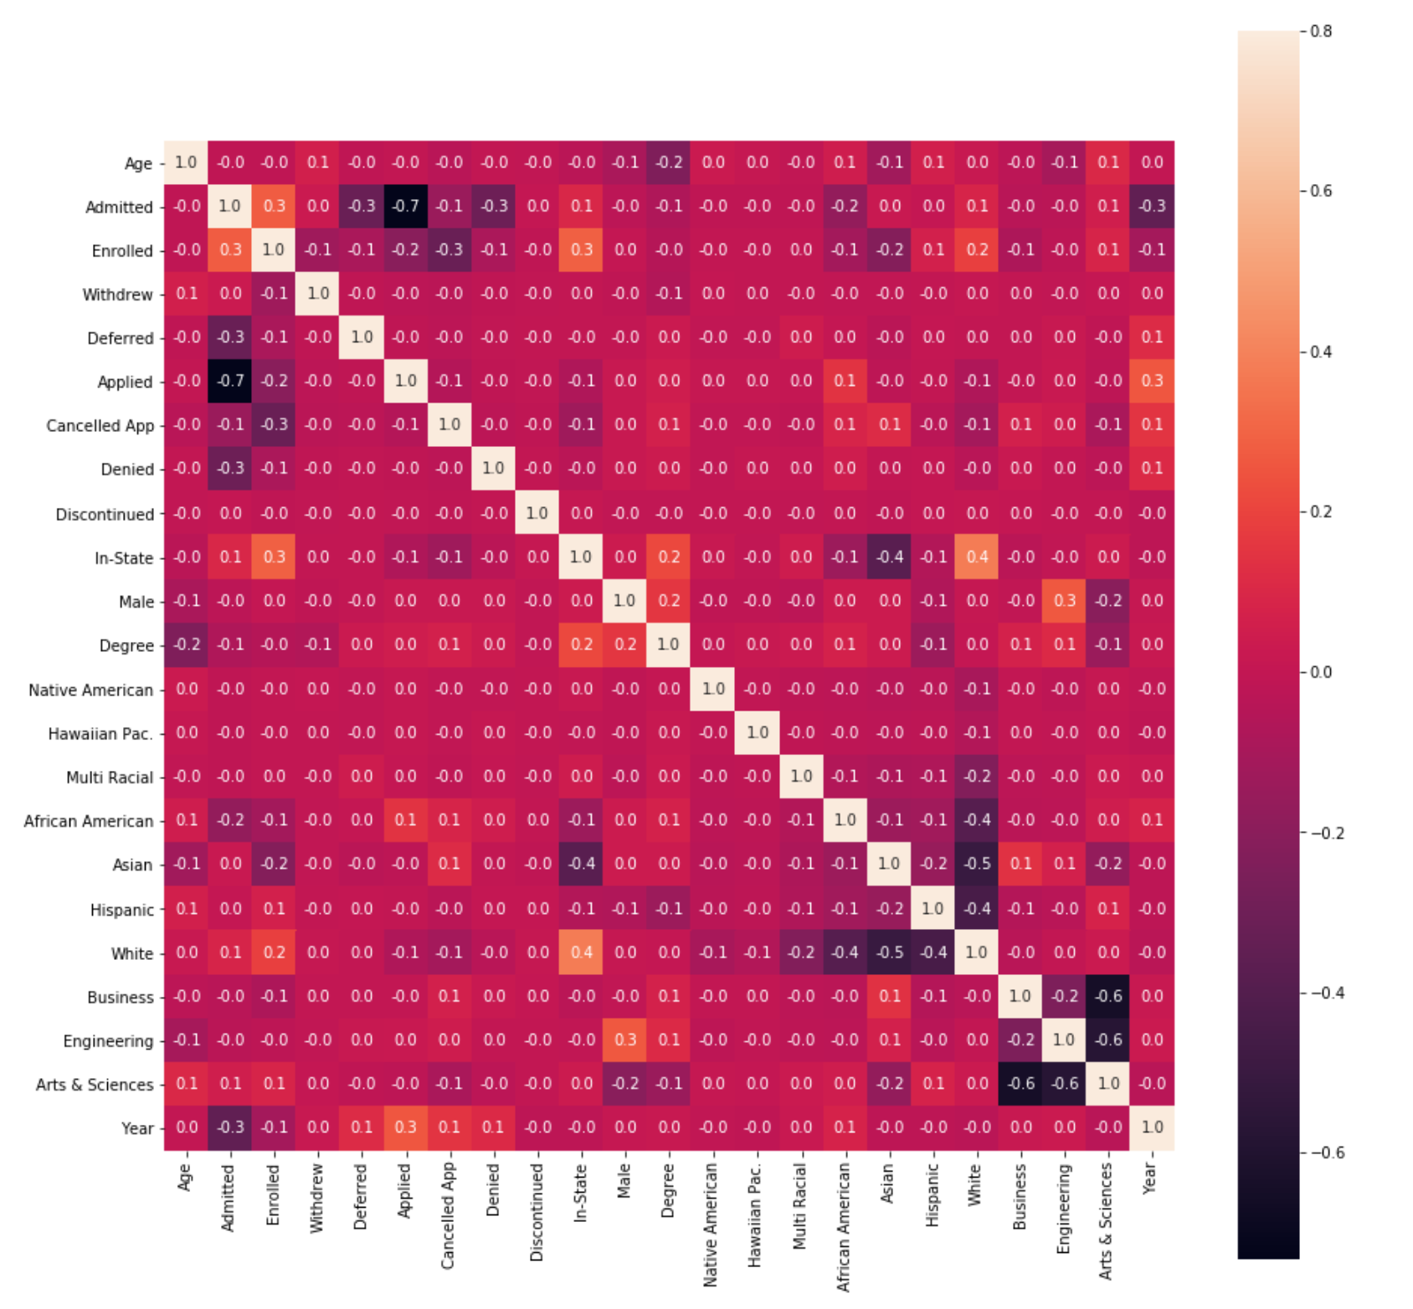
Correlation Analysis – Non-Traditional

Slide 13
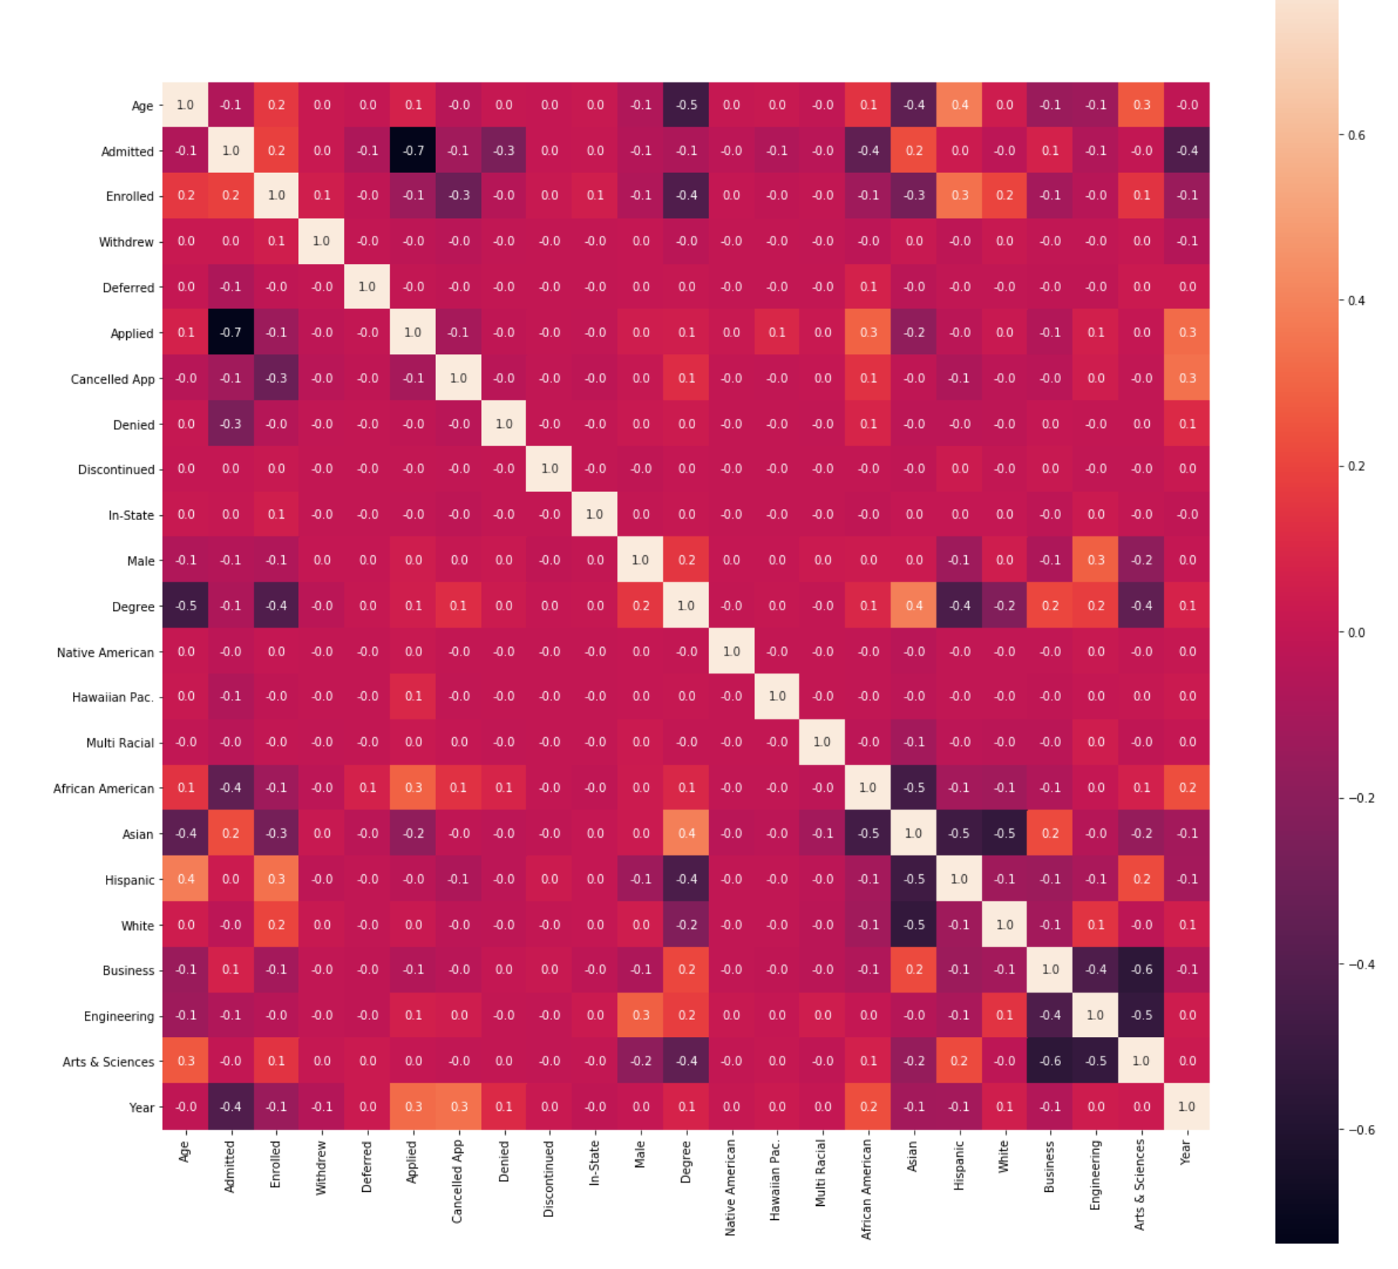
Correlation Analysis – International

Slide 14
Correlation Analysis Results – Side by Side
Freshman
Significant Positive Correlations:
Male & Enrolled
In-State & Enrolled
Male & Engineering
Enrolled & White
Enrolled & Engineering
Applied & Year
In-State & White
Significant Negative Correlations:
Applied & Admitted
Arts&Sciences & Male
In-State & African American
Admitted & Year
Non-Traditional
Significant Positive Correlations:
Male & Degree seeking
In-State & Enrolled
In-State & Enrolled
Enrolled & White
African American & Year
Applied & Year
In-State & White
Significant Negative Correlations:
Male & Age
Degree & Age
Applied & Admitted
In-State & Asian
Admitted & Year
International
Significant Positive Correlations:
Applied & Year
Cancelled App & Year
Asian & Degree
Male & Engineering
Male & Degree
Arts & Sciences & Hispanic
Applied & African American
Age & Arts & Sciences
Significant Negative Correlations:
Admitted & Year
Degree & Arts & Sciences
Male & Arts & Sciences
Male & Age
Male & Admitted / Enrolled
Male & Hispanic
Male & Business
Hispanic & Degree

Slide 15
2 Column Correlation Analysis – A Closer Look
College & Gender
Freshmen
Business & Male – slight positive
Engineering & Male – strong positive
A&S & Male – strong negative
Non-Traditional
Business & Male – slight negative
Engineering & Male – strong positive
A&S & Male – strong negative
International
Business & Male – slight negative
Engineering & Male – strong positive
A&S & Male – strong negative
Gender & Ethnicity
Freshmen
Male & White – slight positive
Male & Asian – slight negative
Male & African American – slight negative
Male & Hispanic – slight negative
Male & Multi Racial – slight negative
Non-Traditional
Male & White– slight negative
Male & Asian – slight positive
Male & African American – slight positive
Male & Hispanic – slight negative
Male & Multi Racial – slight negative
International
Male & White – slight positive
Male & Asian – slight positive
Male & Hispanic – strong negative

Slide 16
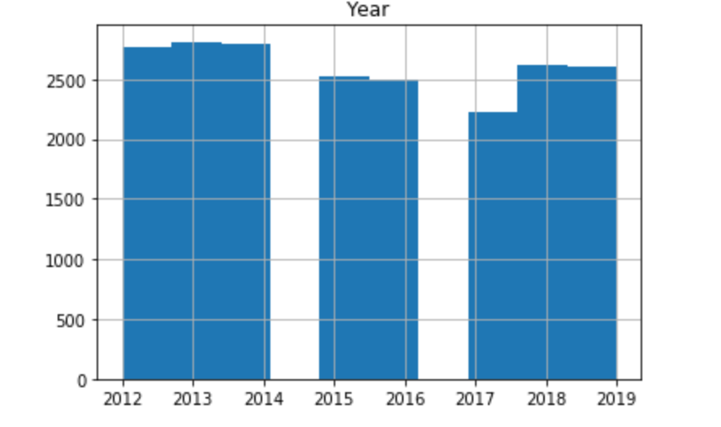
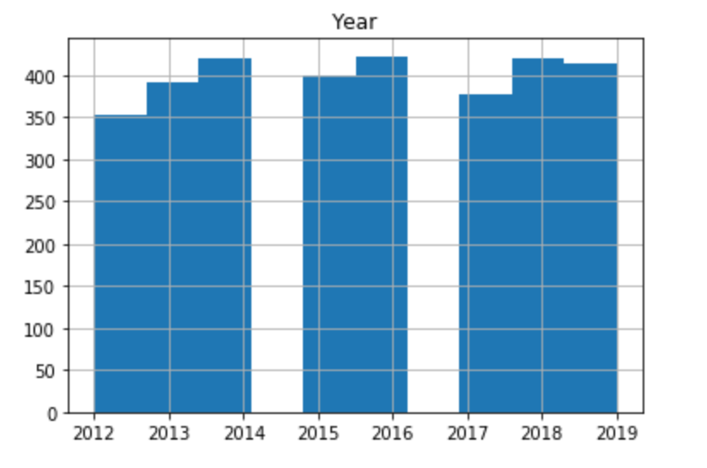
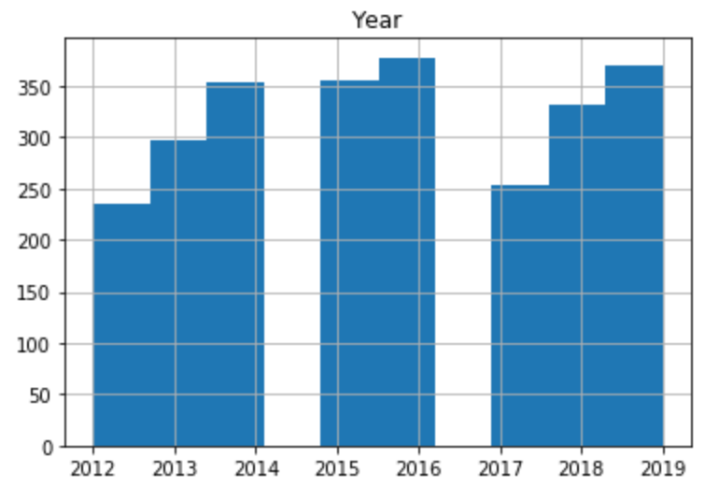
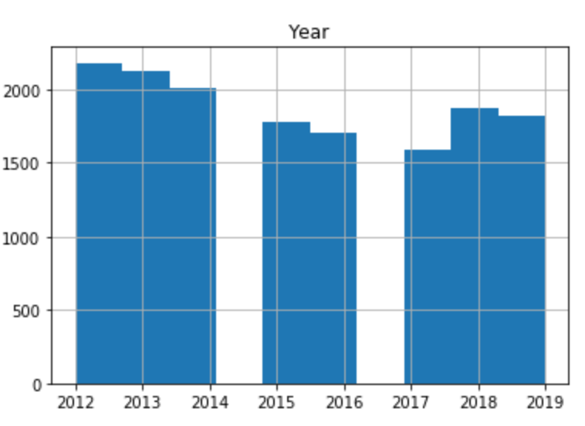
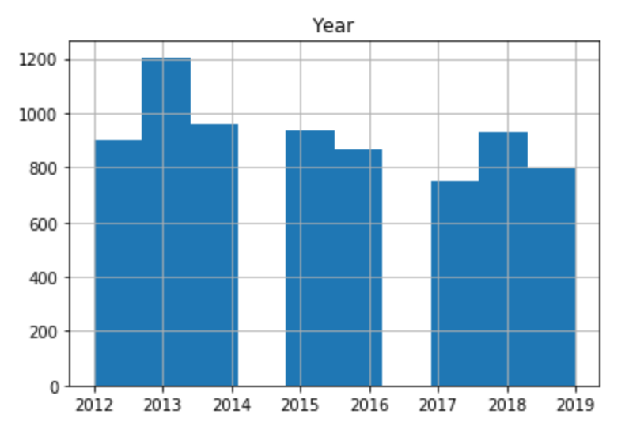
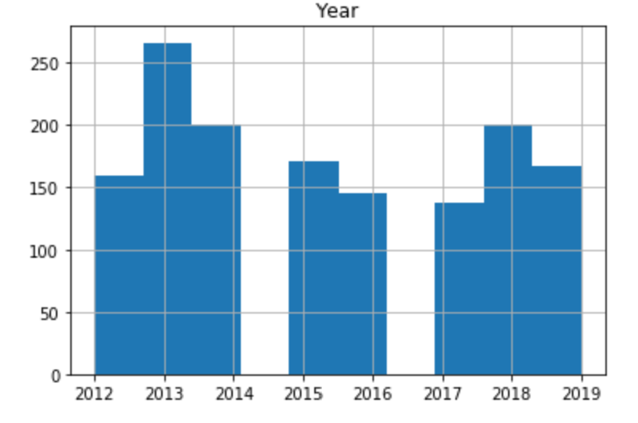
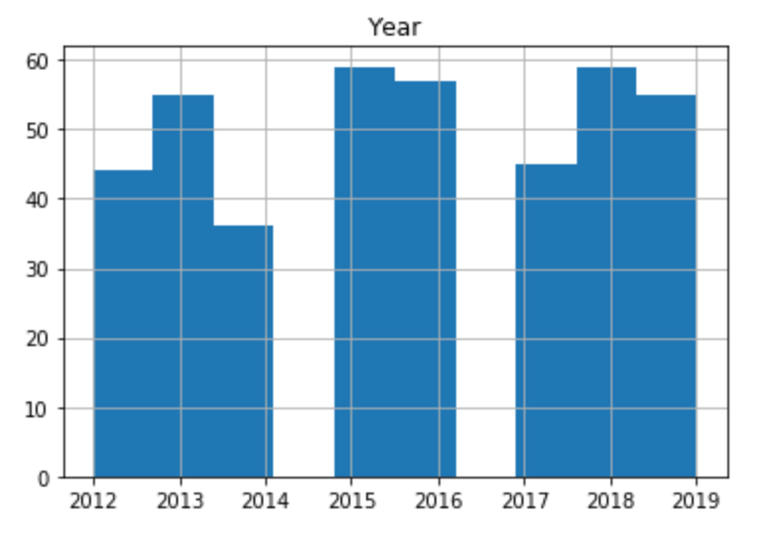
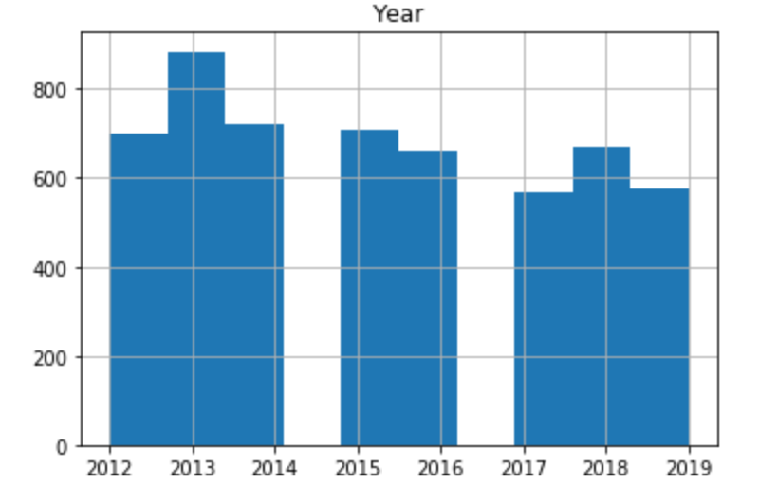
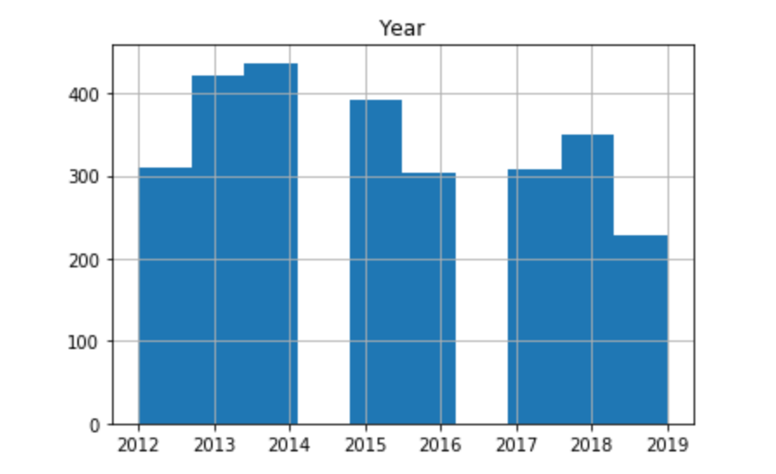
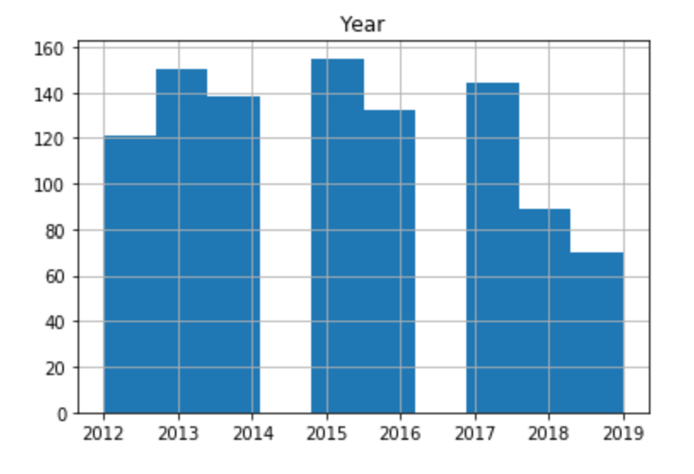
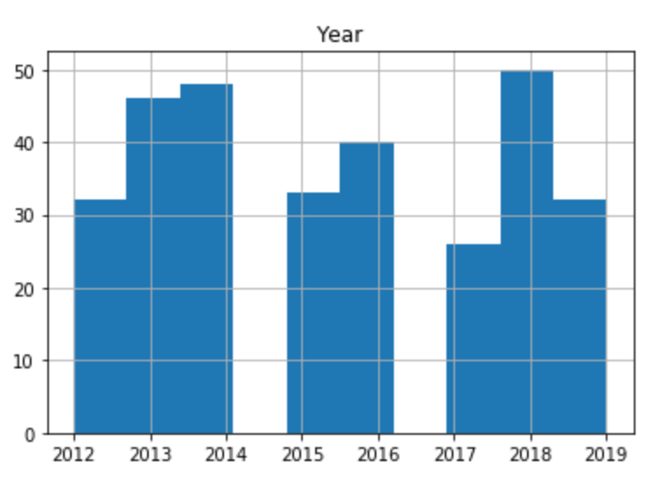
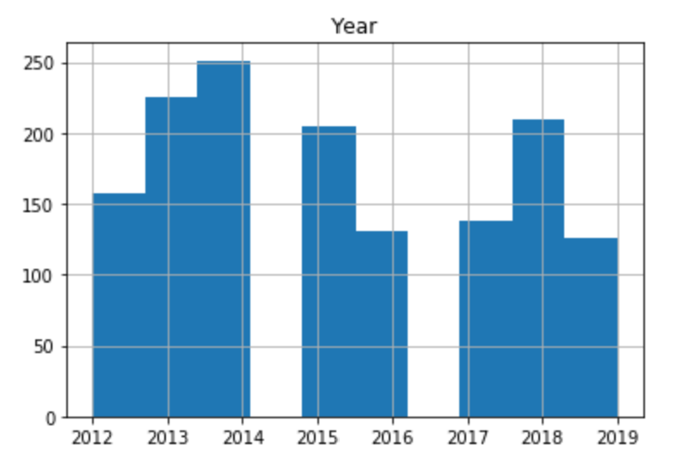
Female Applicant Trends (2012 – 2019) – By Student Type
Overall
Business
Engineering
Arts & Sciences
Freshmen
Non-Traditional
International

Slide 17
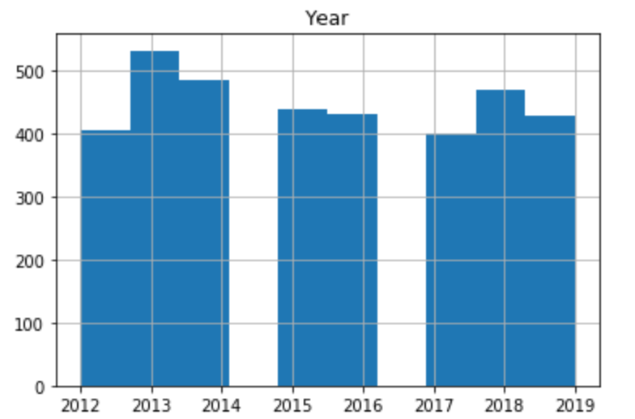
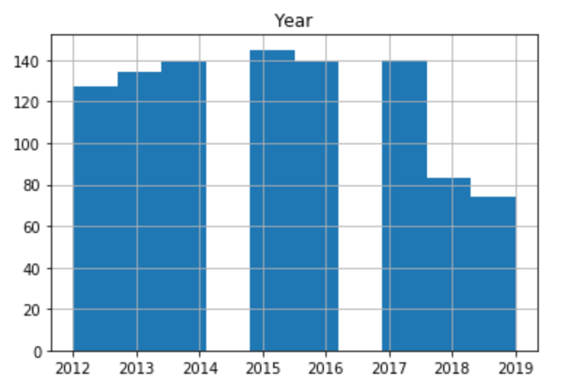
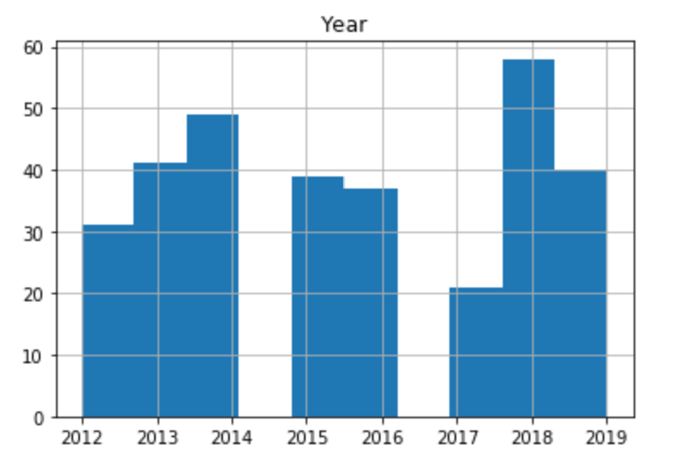
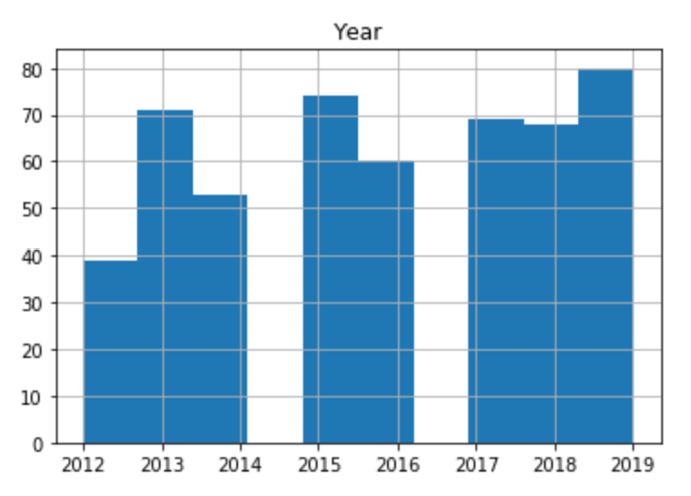
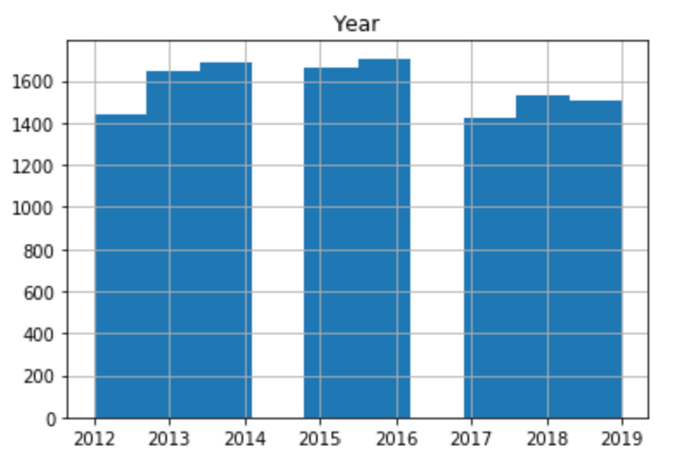
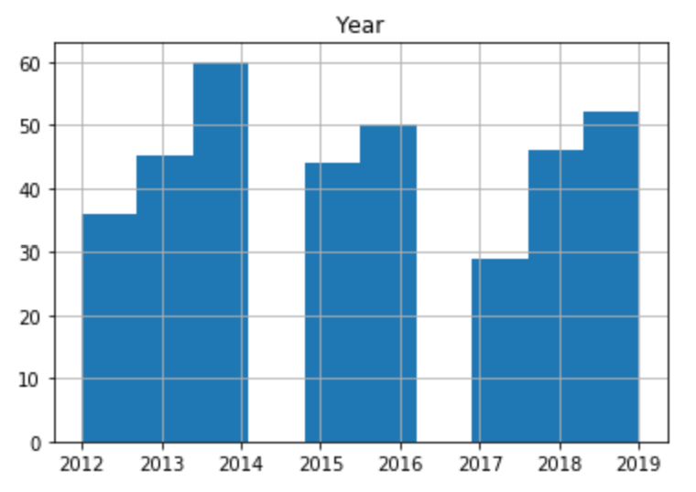
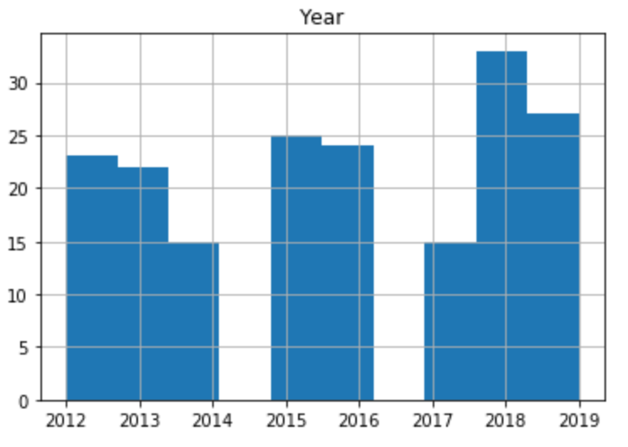
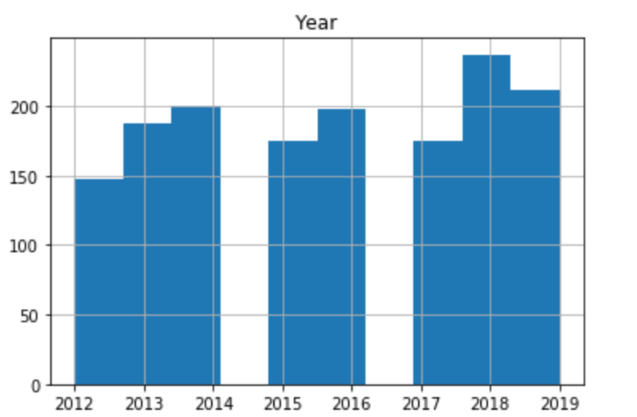
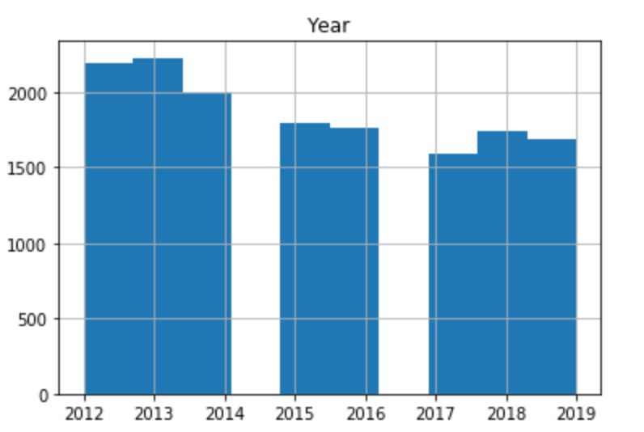
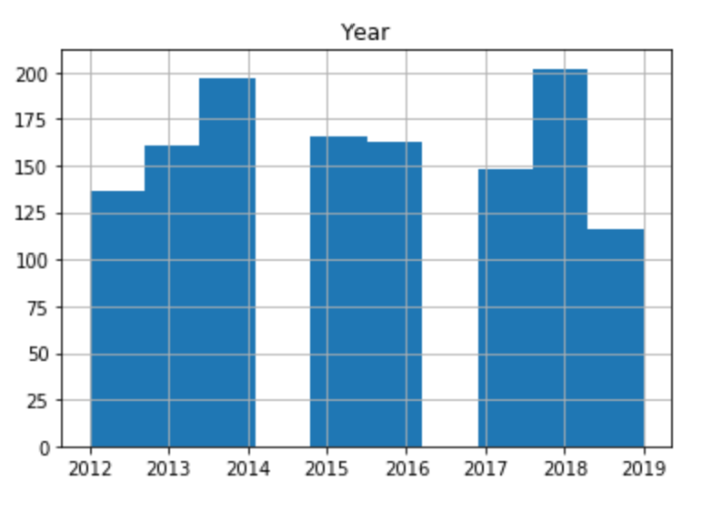
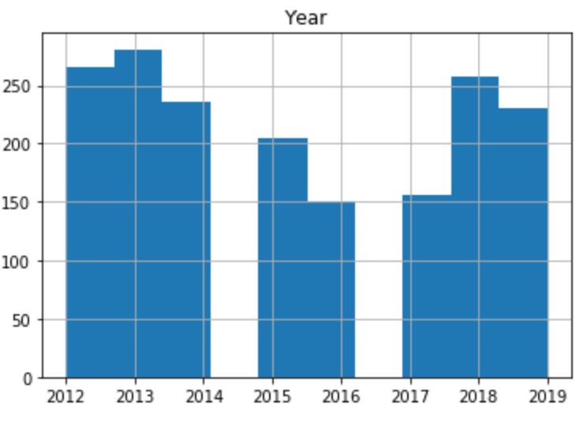
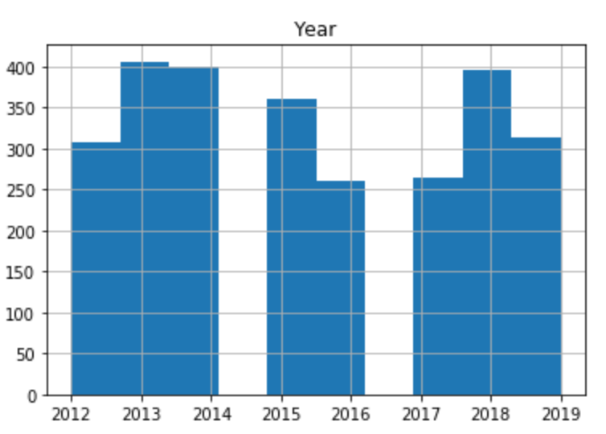
Female Applicant Trends (2012 – 2019) – By Student Type & Ethnicity Breakdown
White
Asian
African American
Hispanic
Business
Engineering
Arts & Sciences

Slide 18
Model Performance – Classification Model
Best Performing Model:
Recursive Feature Selection
Allows for identification of most important factors when looking at specific colleges.
Predominantly male colleges can be identified, even when not initially obvious, along with other significant factors that make up the current student body that aid in applying to prospective female student markets.
Will assist in establishing a target market for colleges dependent on student type / cohort

Slide 19
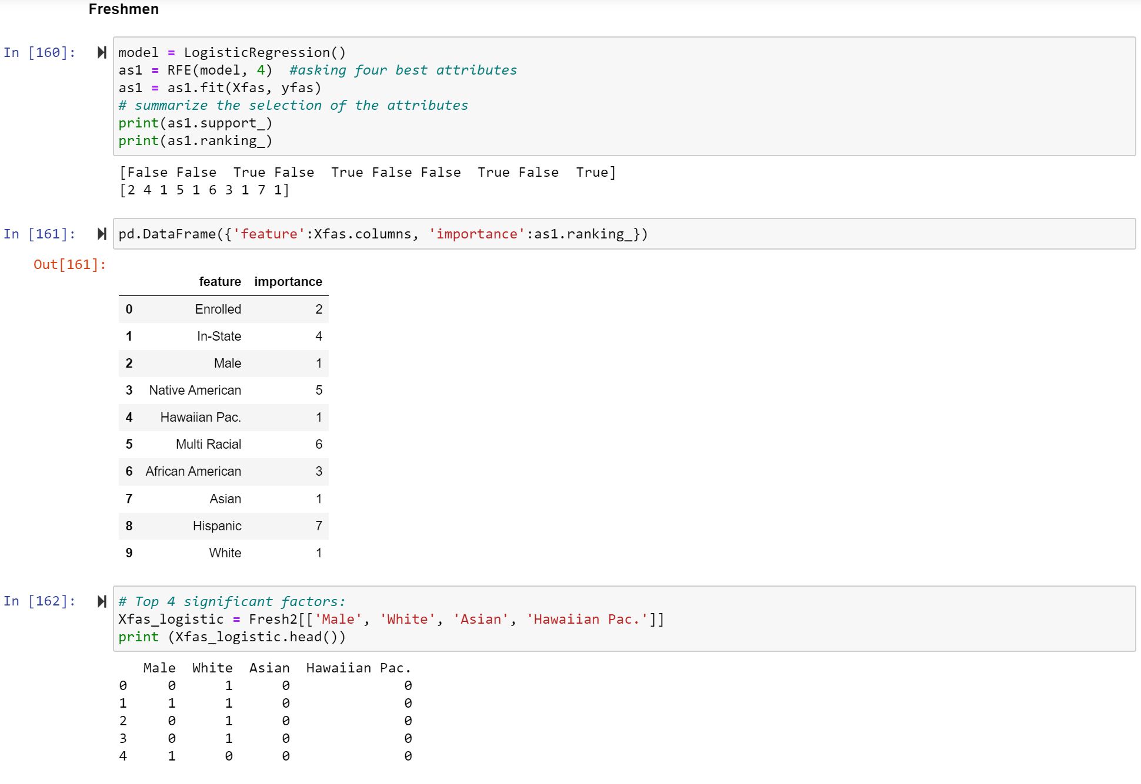
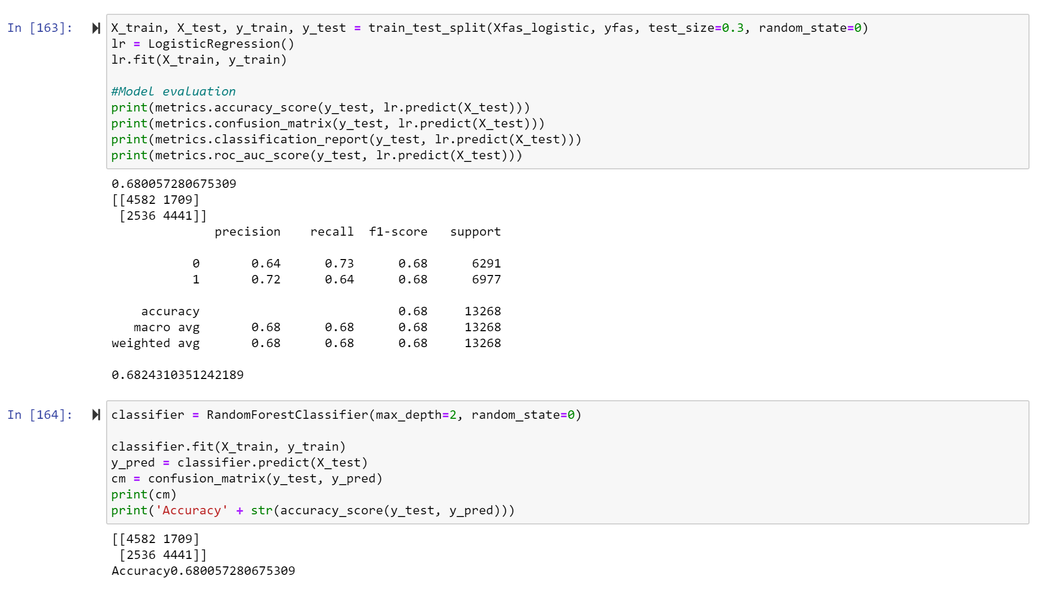

Slide 20
College of Arts & Sciences
Freshman
Most Important Features
Male
Hawaiian Pac.
Asian
White
Accuracy
68%
Non-Traditional
Most Important Features
Male
African American
Asian
Hispanic
Accuracy
63%
International
Most Important Features
Male
Multi Racial
Asian
Hispanic
Accuracy
67%

Slide 21
College of Business
Freshman
Most Important Features
Male
Hawaiian Pac.
Asian
Native American
Accuracy
82%
Non-Traditional
Most Important Features
Enrolled
Multi Racial
Asian
Hispanic
Accuracy
78%
International
Most Important Features
Male
Hawaiian Pac.
Asian
Hispanic
Accuracy
68%

Slide 22
College of Engineering
Freshman
Most Important Features
Enrolled
African American
Asian
Hispanic
Accuracy
71%
Non-Traditional
Most Important Features
Male
Native American
African American
Asian
Accuracy
82%
International
Most Important Features
Male
Native American
White
Multi Racial
Accuracy
71%

Slide 23
Entire Female Student Population
Most Important Features
In-State
Freshman
Degree Seeking
Asian
Closely followed by:
Online
Accuracy
63%

Slide 24
Let’s Take a Look at Tableau Visualizations

Slide 25
Take away – Implications for Enrollment Management Decisions
Impacts of decisions are far-reaching
Tuition amounts
Budgetary decisions
Employment of faculty & Staff
Amenities
Programs offered
Ability to provide students with access to computer labs, etc.
Overall quality of education provided
Remember that some of the data is self-reported by the students
Data is for applicants only up to the point of enrollment
Further analysis required to verify data is consistent with current student body through graduation
Allows to substantiate and enrich already established knowledge by those who are actively engaged with prospective students
Highlight areas where the university is doing well and can use these aspects to their benefit
Student ambassadors to aid recruitment
Emphasize increase in female enrollment trends that overall decrease in enrollment will overshadow
Focus on areas of strength to transition and apply working strategies to areas where there is a lack thereof
Highlight areas where improvement is needed
Example: Engineering could benefit from online programs to allow better accessibility to non-traditional, female students

